Slide 1
Global Teleconsultation Portal (GTP)
Consult Submission

Slide 2
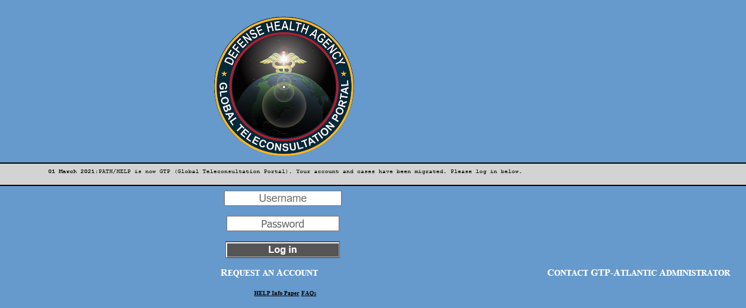
GTP Consultation Procedure
PREFACE
GTP (Global Teleconsultation Platform) is designed to be a worldwide-accessible, HIPAA-compliant, secure, web-based system for health care personnel (IDC, RN, NP, PA, Physicians) allowing them access to medical specialists from the PATH/GTP System. The area of coverage includes EUCOM, CENTCOM, and AFRICOM and their regionally associated Fleet, Army, Air Force and Marine assets.
HOW TO PLACE A CONSULT REQUEST IN GTP
Start by going to the login page: https://help.nmcp.med.navy.mil/path/user/Login.jsp
If you don’t already have an account, request an account by clicking Request an Account.
For further guidance on requesting an account refer to slides 14-16

Slide 3
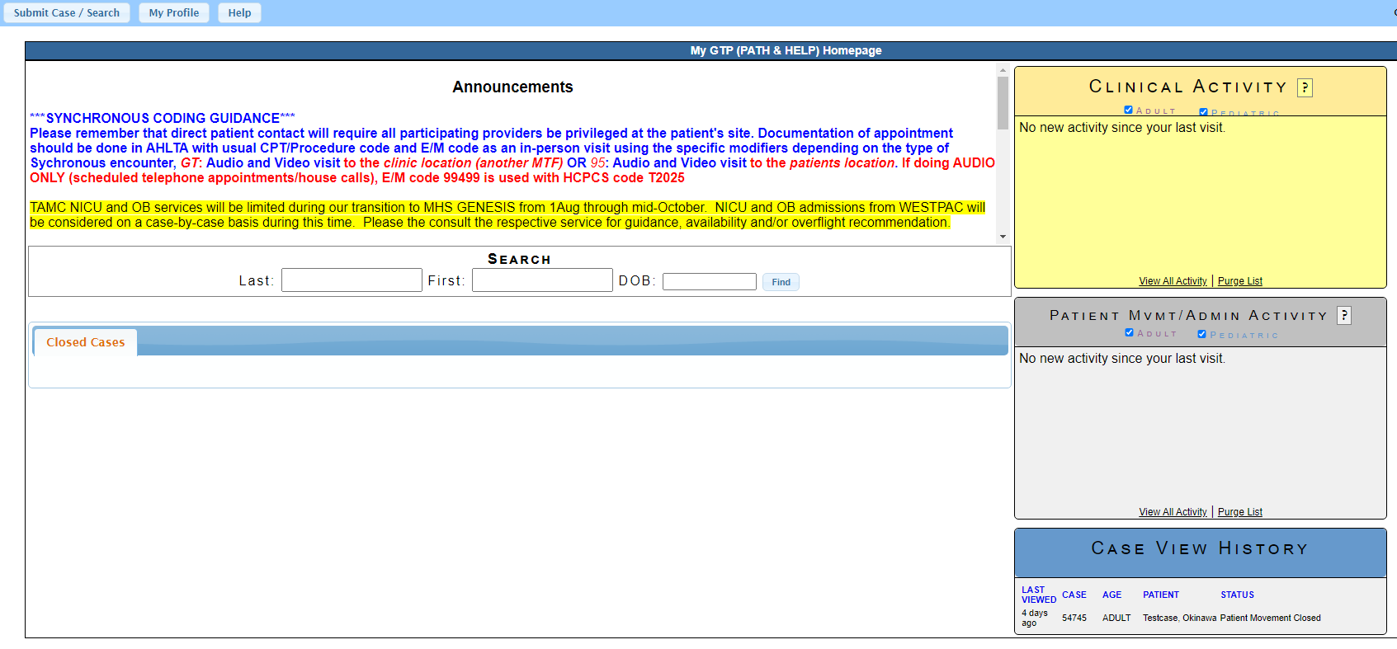
Creating a GTP Consult
Click on Submit Case / Search, this will open up the Patient Search dialog box

Slide 4
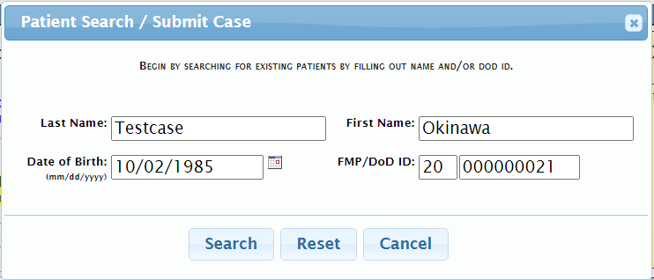
Patient Information
Fill out the fields
Click search, this will search for all cases created under your patient’s name

Slide 5
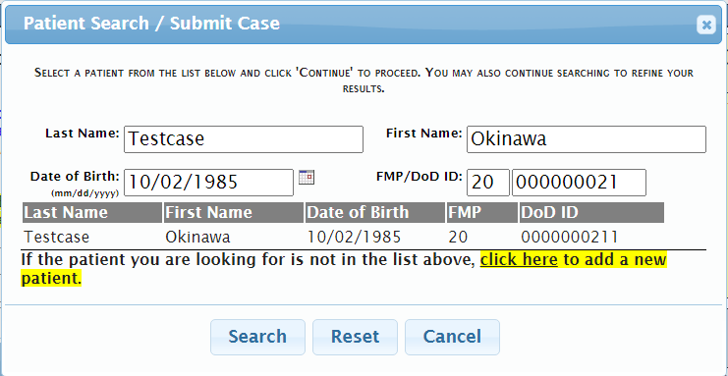
Existing Patient
If the patient already exist, select the name
For new patient select “click here to add new patient”

Slide 6
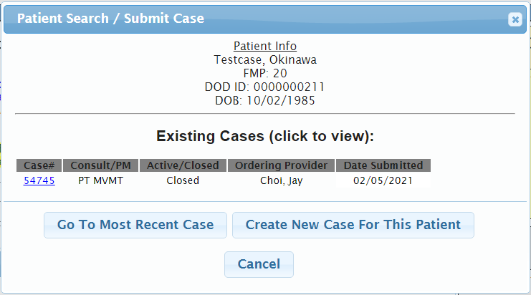
Creating a New Consult
After selecting existing patient, if you need to create a new case for the patient, select “Create New Case For This Patient”
If creating a consult, ensure you search for pre-existing case correlating to Consult to prevent a duplicate case
If no corresponding, pre-existing case, then create a new consult

Slide 7
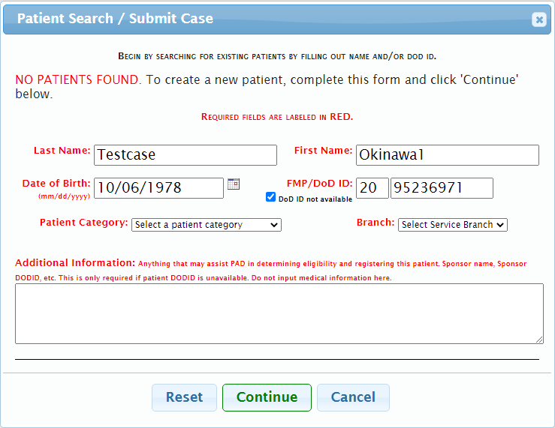
Patient not found?
If the patient is not found, that means a consult has not been created
Complete the rest of the form to create a new case, then click Continue
Double check correctness of demographics prior to selecting “continue”

Slide 8
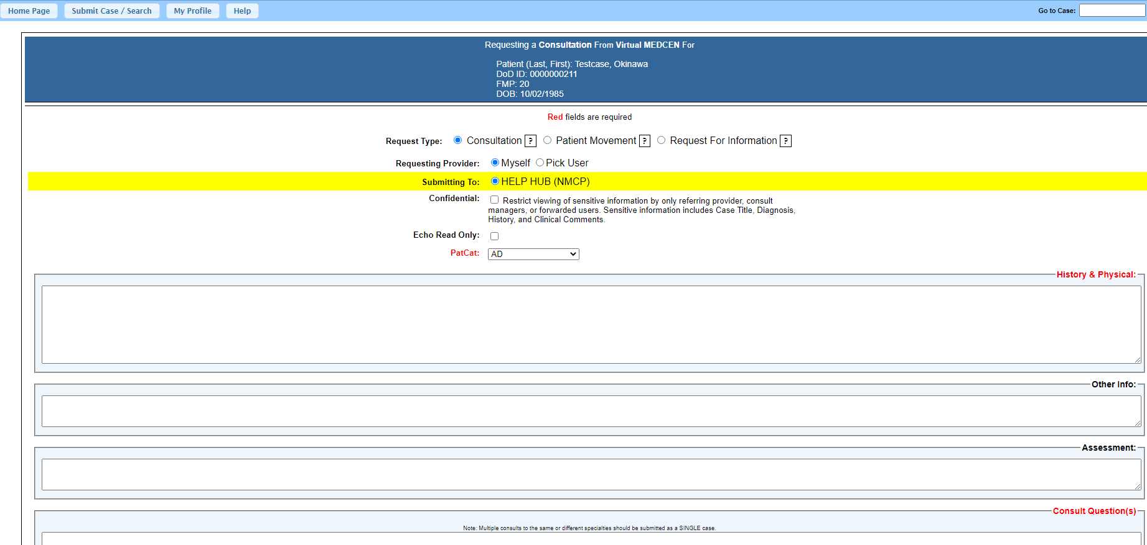
New Consultation
In the consult window, set Request Type: to Consultation
Select “Myself” unless you are submitting on a supervising provider’s behalf. The system will auto populate the command from your profile.
Submitting to will be selected by your regional location
(EUCOM, CENTCOM & AFRICOM regions will submit to LRMC)
Request Type: Patient Movement or RFI may be selected if applicable)
Confidential box will restrict viewers when checked to a need to know category. Only individuals added to the case will have access to view the case.
Types of case that MUST be marked Confidential:
Behavioral Health
OB/GYN Related
Consults including patient photographs

Slide 9
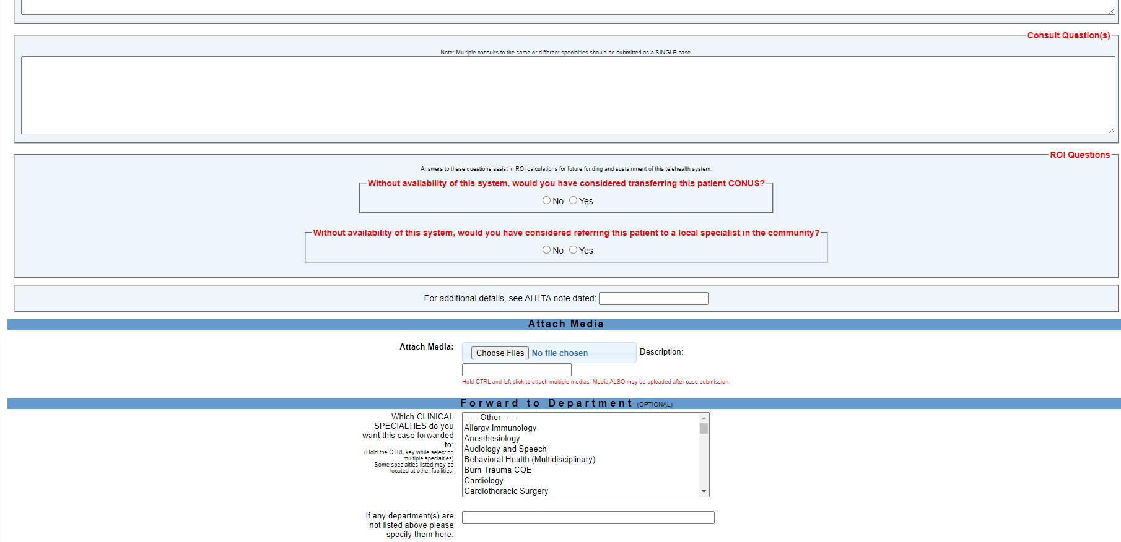
New Consultation
Enter pertinent information about patient in the appropriate fields
History & Physical and Consult Question(s) fields are mandatory
MUST upload images related to the consultation
Select the medical Specialty you want to review your case if not listed add specialty in the box, Submit case when done
Case Submission: When submitting a consult, you MUST send a complete medical history and the most current assessment findings, and state a clear consult question. This will help ensure timely and accurate responses from specialists. MUST attach images when appropriate (varieties of different file formats are supported). You can refer to AHLTA notes on specific dates as necessary, but be sure to add the pertinent info to the GTP consultation. Also, please note that you (the referring provider) maintain full responsibility for the care of your patient during the consultation process.

Slide 10
The Consult is in GTP!

Slide 11
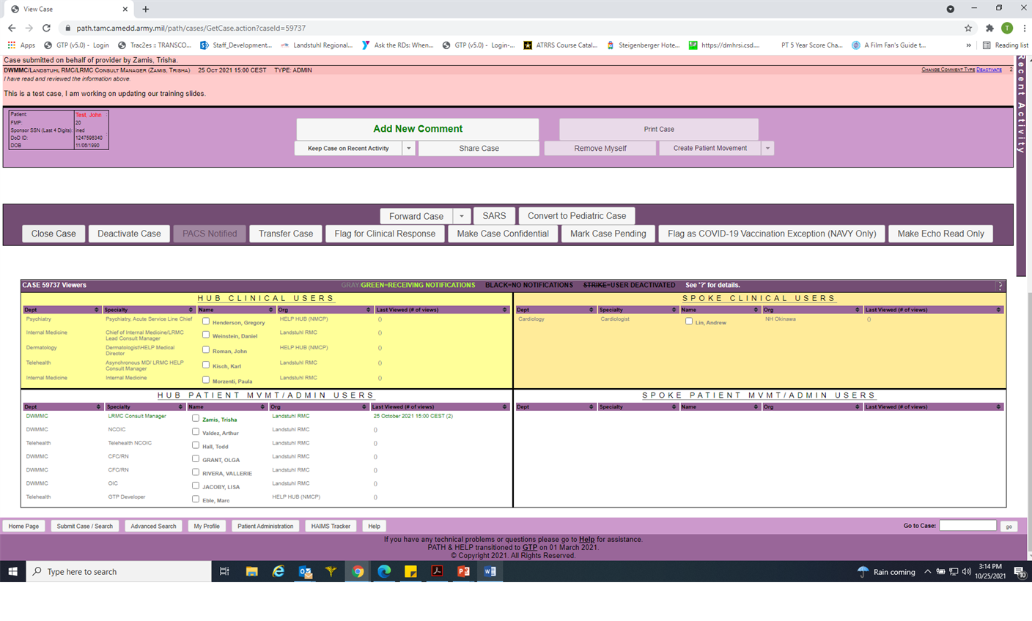
Requesting Case Closure
Go to the consult and click the Close Case button located under the Add New Comment section

Slide 12
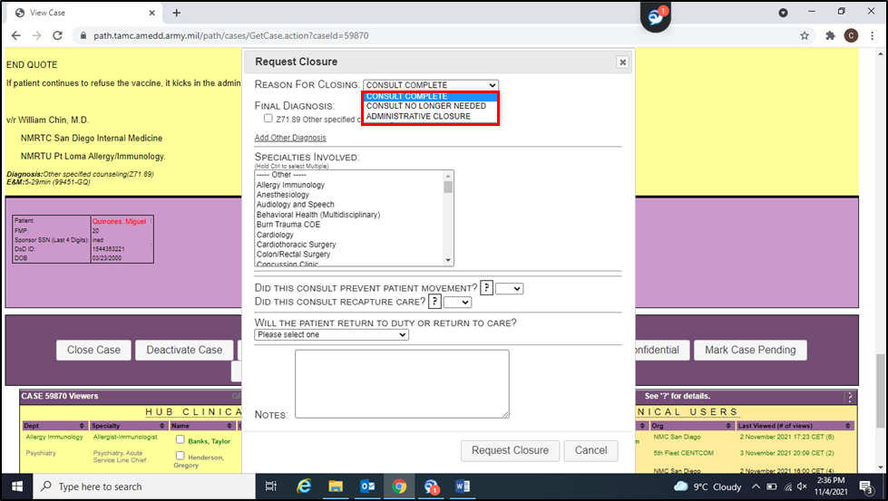
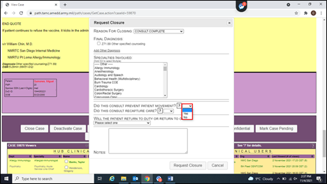
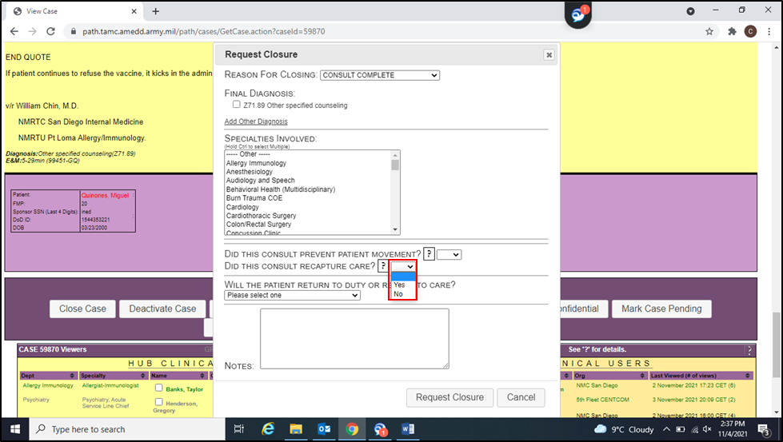
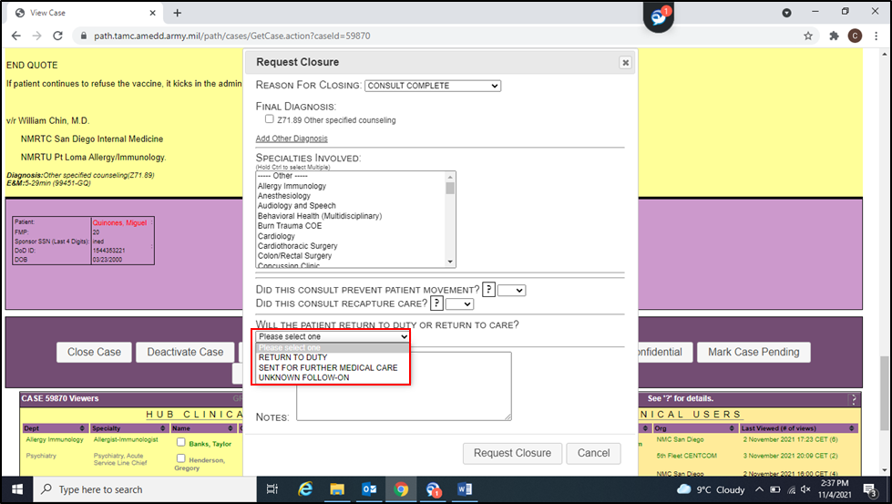
Requesting Case Closure
Select CONSULT COMPLETE from the drop down menu
Select Yes or No if the consult prevented patient movement
Select Yes or No if the consult recaptured care
Select the appropriate response for “will the patient return to duty or return to care”
Then, click on Request Closure button

Slide 13
Case Closure
Example of a completed closure request

Slide 14
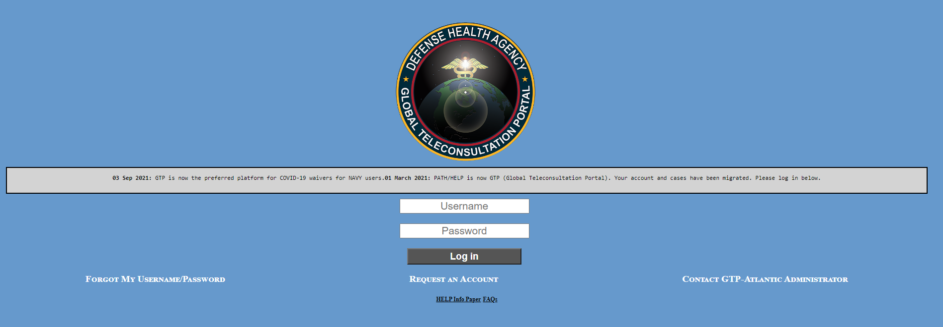
GTP Account and Access
Click on: https://help.nmcp.med.navy.mil/path/user/Login.jsp to get to the home screen on the GTP site
Click Request an Account

Slide 15
Requesting a GTP Account
MUST fill in all required fields, then click next

Slide 16
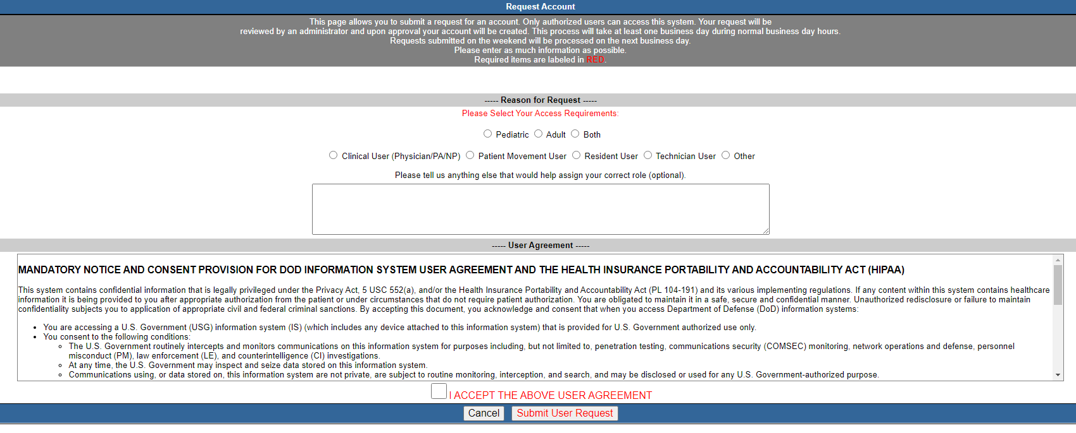
Requesting a GTP Account
Fill in required fields
Click “I accept the above user agreement” box
Select “Submit User Request” tab
Once submitted the request will be reviewed and approved by an administrator

Slide 17
Training POCs
LCDR John W. Roman – GTP Medical Director
LTC Charles T. Nguyen – GTP Medical Director
Mr. Kevin D. Ross – GTP Program Manager
Mrs. Karissa L. Flynn – GTP Atlantic Program Manager
Ms. Sylvia E. Grun – Indo-Pacific Program Manager
GTP HELP DESK
https://gsc.health.mil 1-800-600-9332

